Slide 1
SDEV2150
Lesson 05: Asynchronous Data

Slide 2
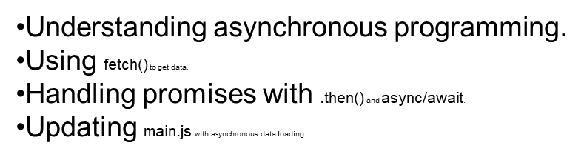
Lesson Objectives
In this lesson, students will:
PART-1
PART-2

Slide 3
Agenda
Review synchronous vs asynchronous execution
Review fetch and async data loading
Instructor demo
Refactor: component-driven fetching
Practice and reflection

Slide 4
Connecting

Slide 5
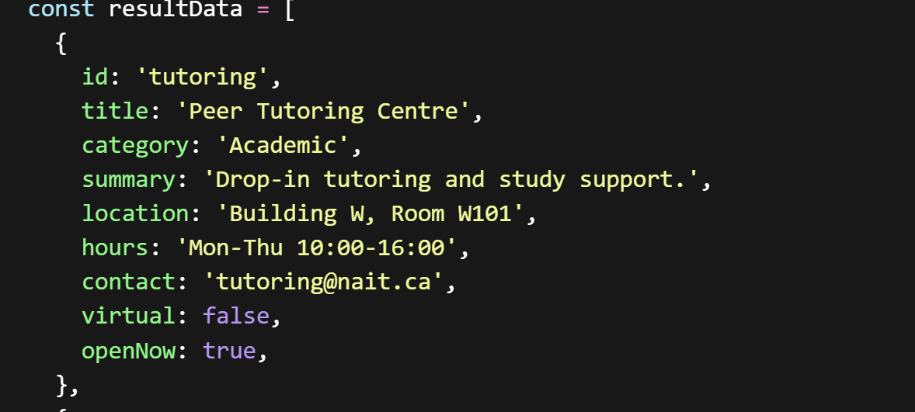
Original Hard-coded Data
Currently, the project uses static data.
Every time you want to update resources, you must edit main.js manually.
This is not scalable.

Slide 6
Why async matters
JavaScript runs on a single thread. If we made network requests or heavy operations synchronously:
The UI would freeze
Users could not interact with the page
Results would feel slow and unresponsive
Asynchronous programming allows us to:
Fetch data in the background
Keep the UI responsive
Update components only when data is ready

Slide 7
// main.js
// Fetch resource data from a JSON file asynchronously
async function getResources() {
try {
const response = await fetch('./data/resources.json'); // fetch returns a promise
if (!response.ok) throw new Error('Network response was not ok');
const resultData = await response.json(); // parse JSON asynchronously
return resultData;
} catch (error) {
console.error('Error fetching resources:', error);
return []; // fallback to empty array if error occurs
}
}

Slide 8
Think of async like ordering food:
You place the order (fetch)
You don’t stand frozen at the counter
You get notified when it’s ready
Then you eat (render)
eturns a Promise.

Slide 9
Mental Model

Slide 10
JavaScript does not block
Long operations move off the call stack
Results come back later
Code reacts when data arrives
This lesson focuses on reacting to data over time.

Slide 11
Promises
In JavaScript, a function or method returns a Promise object when it needs to manage an operation that cannot be completed immediately, such as a network request or a timer. The promise acts as a placeholder for the eventual result or error.

Slide 12
What a Promise represents
JavaScript uses Promises for async operations. The Fetch API returns a promise.
A value that will exist later
One of three states:
pending
fulfilled
rejected
Promises model work that hasn’t finished yet.

Slide 13
Promise Chaining

Slide 14
Handling steps in order
fetch(url)
.then(res => res.json())
.then(data => console.log(data))
.catch(err => console.error(err));
Each .then() waits for the previous step
Errors bubble to .catch()

Slide 15
async / await

Slide 16
Promise syntax made readable
try {
const res = await fetch(url);
const data = await res.json();
} catch (err) {
console.error(err);
}
async/await does not replace Promises, it uses them.
Here’s the mental model:
fetch(url) returns a Promise
await pauses this function until that Promise settles
If the Promise:
fulfills → you get the resolved value
rejects → it throws, and control jumps to catch

Slide 17
Promise syntax made readable
async/await is a modern syntax feature in JavaScript that provides a cleaner, more readable way to work with promises, which are the underlying mechanism for managing asynchronous operations. It doesn't replace promises but provides "syntactic sugar" over them to overcome issues related to readability, complex chaining, and error handling.
fetch(url)
.then(res => {
return res.json();
})
.then(data => {
// use data here
})
.catch(err => {
console.error(err);
});

Slide 18
Promise.all()

Slide 19
Coordinating multiple async tasks
const [a, b] = await Promise.all([
fetch(urlA),
fetch(urlB),
]);
Runs async operations in parallel
Resolves when all complete
Rejects if any fail

Slide 20
Stage 1: Fetch COORDINATION

Slide 21
Starting simple
Application loads
The app container/shell fetches resources
Data is passed into components
Everything is explicit and easy to trace.

Slide 22
Fetching Data

Slide 23
Using fetch with async/await
const response = await fetch(url);
const data = await response.json();
Await pauses this function
The app keeps running
Data arrives later

Slide 24
Coordinating Data

Slide 25
App shell as coordinator
Owns the fetch
Handles success and failure
Pushes data into components
Components stay focused on rendering.

Slide 26
Async States

Slide 27
What we're not solving yet
Loading indicators
Error messages
Retry logic
We note these now and add them later.

Slide 28
Stage 2: Component Fetching

Slide 29
Making components reusable
Instead of fetching in the app shell (e.g., index.js or main.js), we let the component load its own data.

Slide 30
Passing the endpoint

Slide 31
Attribute-driven data
<component attribute="http://url-to-some/data"></component>
Attribute defines where data comes from
Component decides how to fetch and render

Slide 32
Reactive Attribute Changes

Slide 33
A new reactive pattern
Attribute changes
Async side effect runs
Component updates state
UI re-renders
This mirrors how frameworks behave.

Slide 34
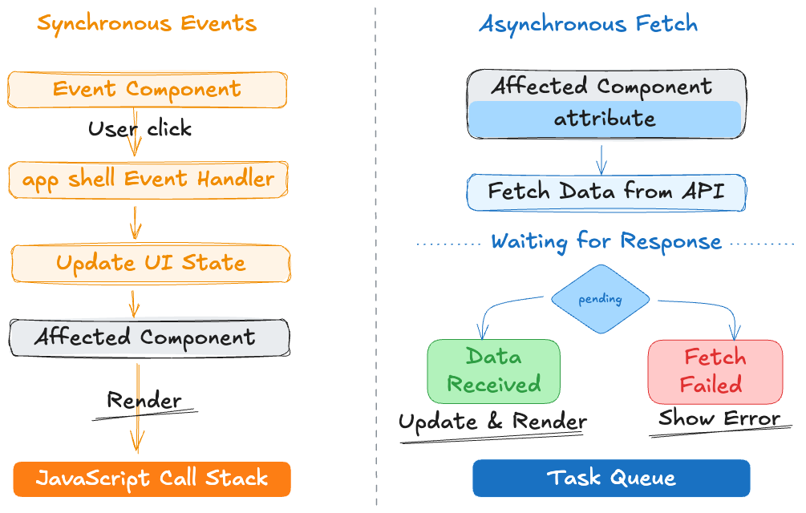
Sync vs. Async

Slide 35
Comparing the Approaches

Slide 36
Fetch in app shell
Fetch in the component
Clear and explicit
Easy to debug
Centralized coordination
But app shell can grow quickly.
Reusable and portable
Encapsulated async logic
Cleaner app bootstrap
But more complex component code.

Slide 37
Real-World Perspective

Slide 38
You'll see both patterns
App shells fetching data
Components loading their own resources
Shared data services
The best choice depends on context.

Slide 39
Hands-on Practice
Exercise: Update an existing component-based app load asynchronous data
Objective: Implement fetch API to retrieve and display dynamic data
Obtain the exercise starter files
Fetch resources from the backend API
Render results when data arrives
Keep filtering and selection working
Ask questions if you are unsure of what to do or how the code works.

Slide 40
Lesson Summary
In this lesson, we covered the following:
Explain how JavaScript handles asynchronous operations
Use fetch with async / await to load data
Describe how async data flows through an application
Compare two approaches to coordinating fetched data
Complete lesson 5 checklist

Slide 41
Exit Ticket
“Where does async work actually happen?”
“When would you fetch in a component instead of the app shell?”

